Slide 1

Deep Learning
Session 18
Introduction to Attention
Applied Data Science
2024/2025

Slide 2
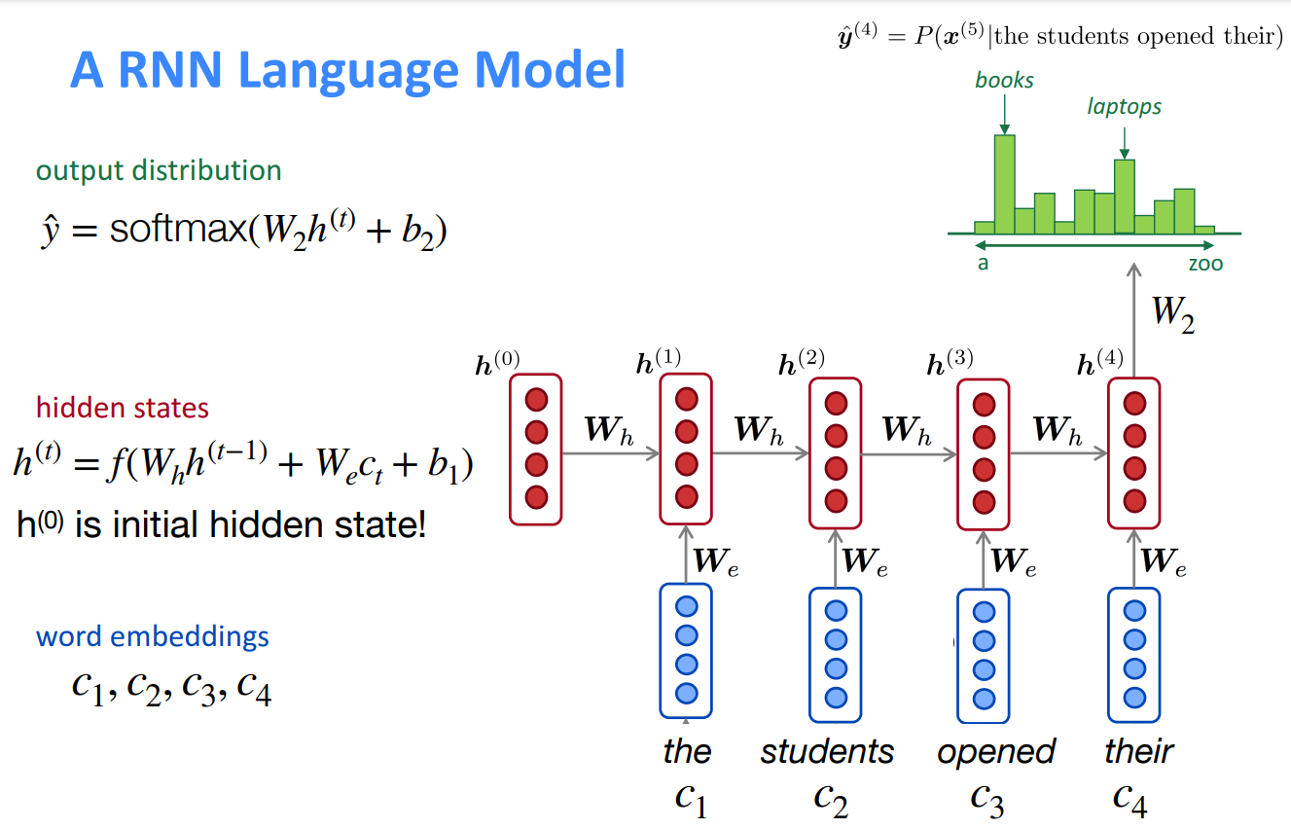
Recap: RNNs
Introduction to Attention
Session 18

Slide 3
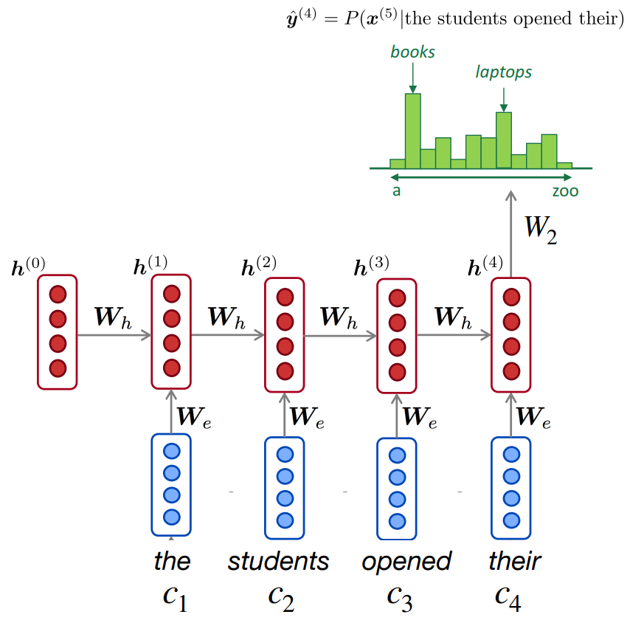
Recap: RNNs
RNN Advantages:
Can process any length input
Model size doesn't increase for longer input
Computation for step t can (in theory) use information from
many steps back.
Weights are shared across timesteps
RNN Disadvantages:
Recurrent computation is slow
In practice, difficult to access information
from many steps back.
Introduction to Attention
Session 18

Slide 4
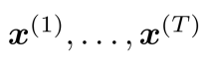
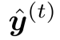
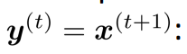
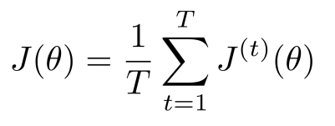
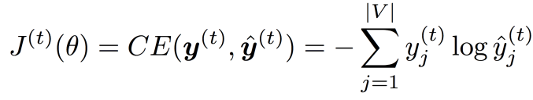
Recap: Training a RNN Language Model
Get a big corpus of text which is a sequence of words
Fed it into the RNN. Compute the outpur distribution for every step t.
i.e. predict the probability distribution of every word given the words so far
Loss funtion on step t is usualy cross-entropy between the predicted probability distribution , and the true next word
Average to get the overall loss!
Introduction to Attention
Session 18

Slide 5
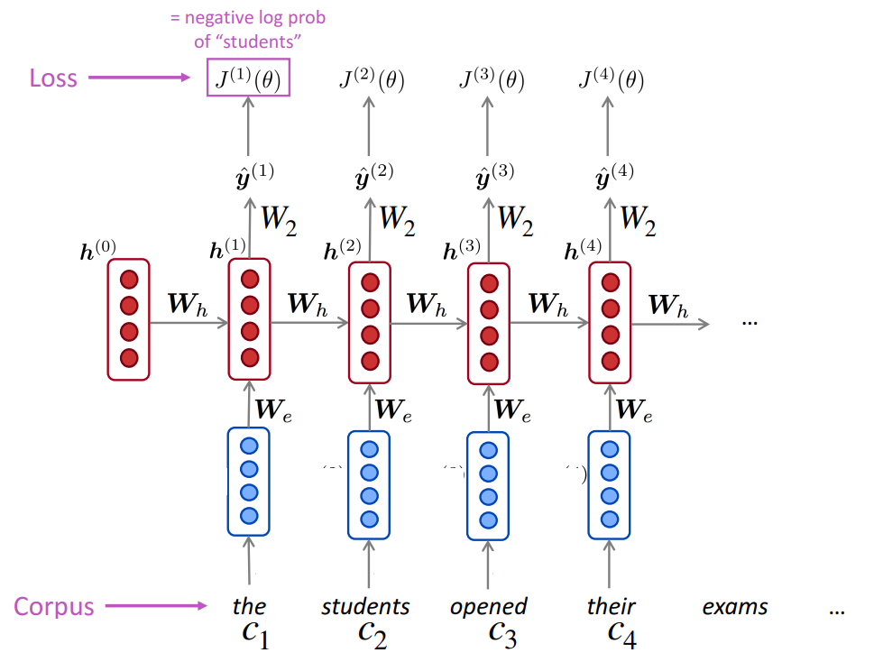
Recap: Training a RNN Language Model
Introduction to Attention
Session 18

Slide 6
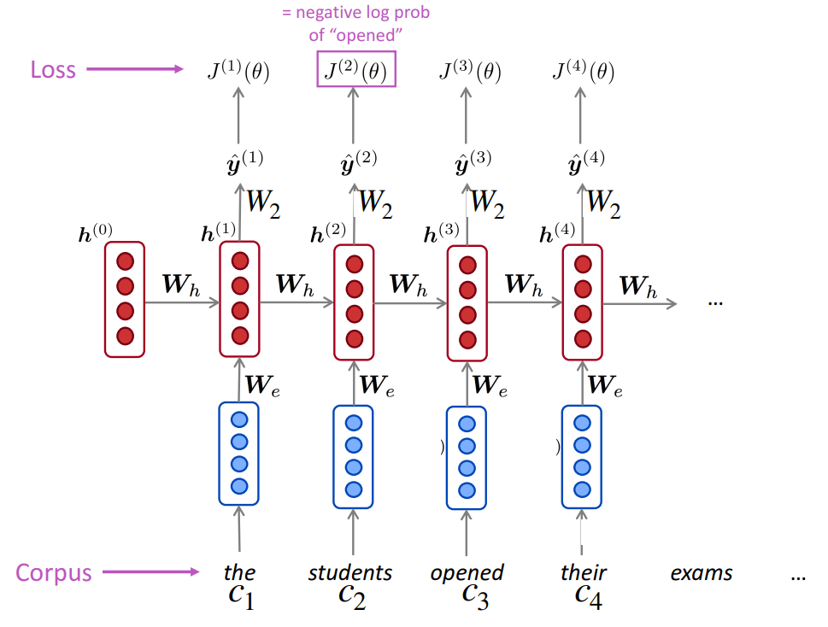
Recap: Training a RNN Language Model
Introduction to Attention
Session 18

Slide 7
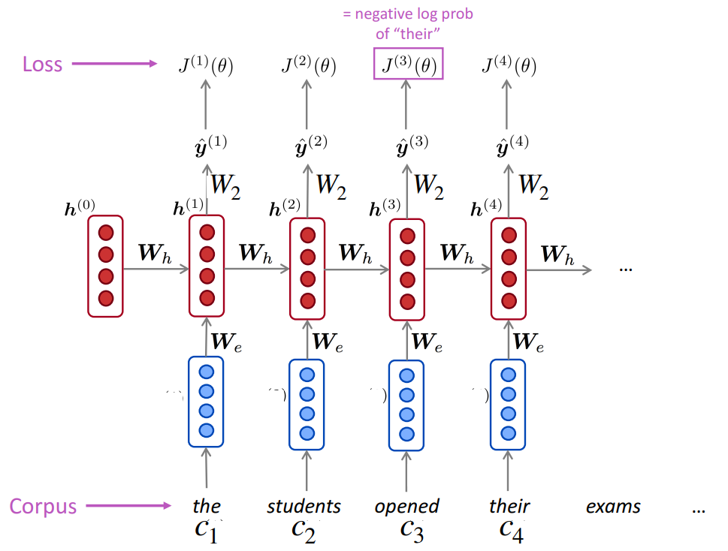
Recap: Training a RNN Language Model
Introduction to Attention
Session 18

Slide 8
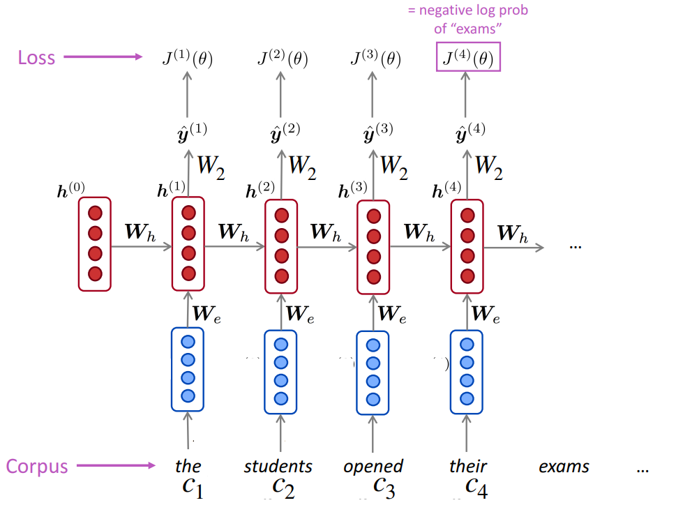
Recap: Training a RNN Language Model
Introduction to Attention
Session 18

Slide 9
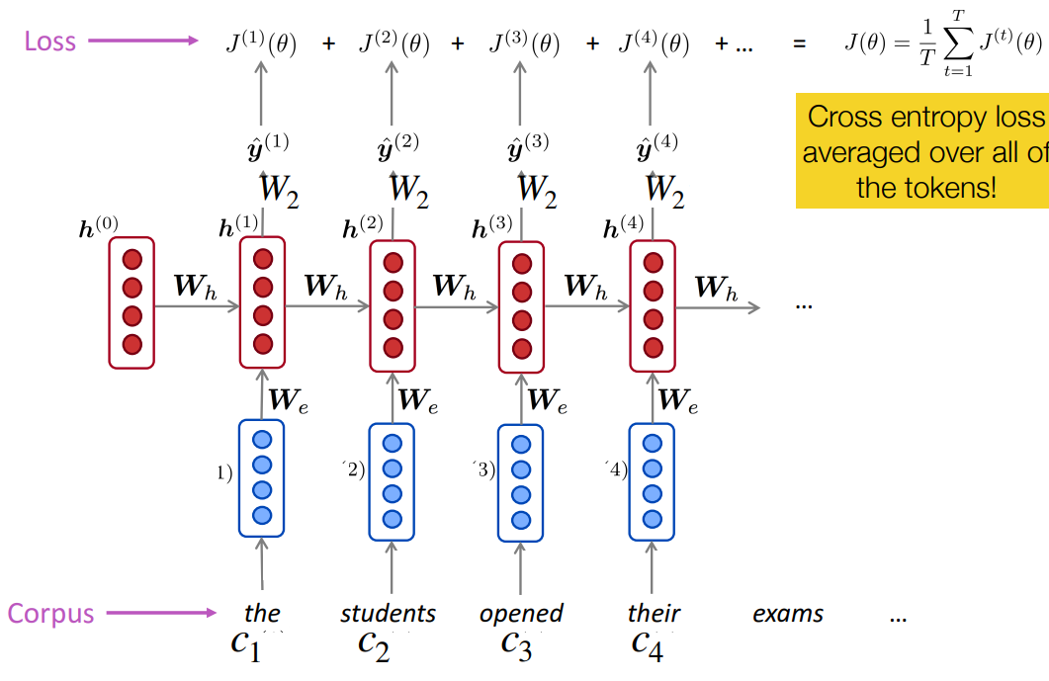
Recap: Training a RNN Language Model
Cross-entropy loss averaged over all of the tokens.
Introduction to Attention
Session 18

Slide 10
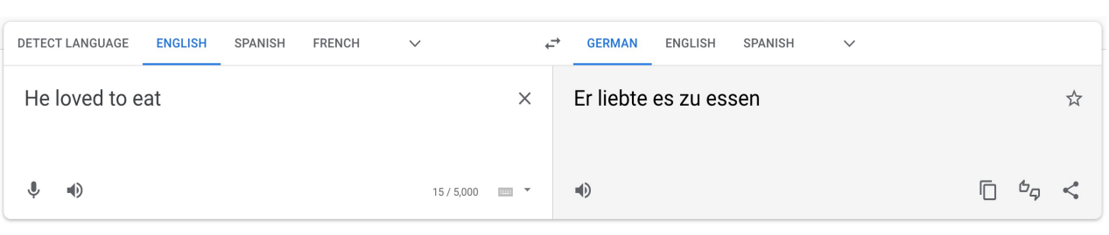
Task: Machine Translation
Introduction to Attention
Session 18

Slide 11
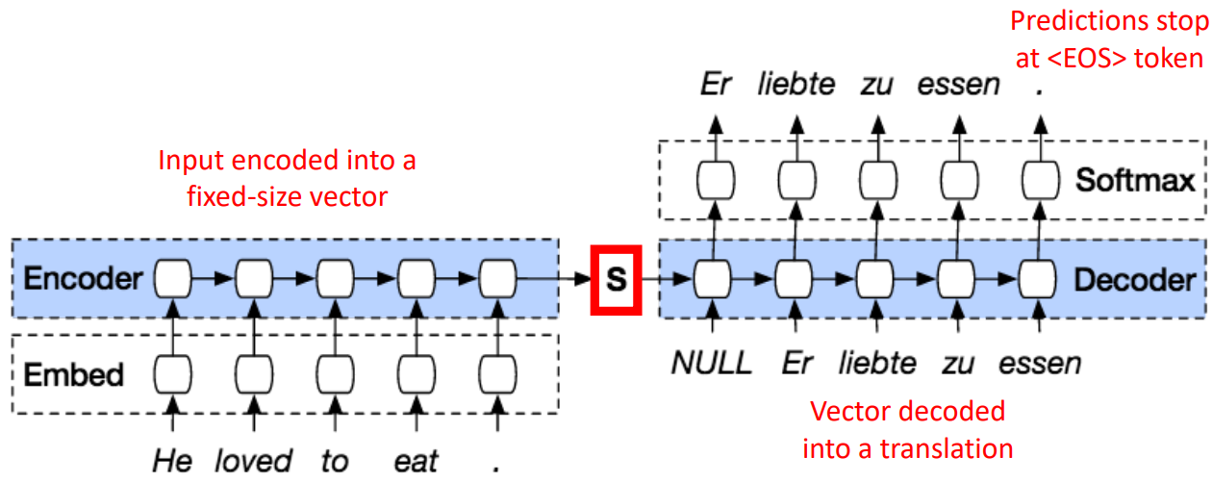
Task: Machine Translation
Introduction to Attention
Session 18

Slide 12
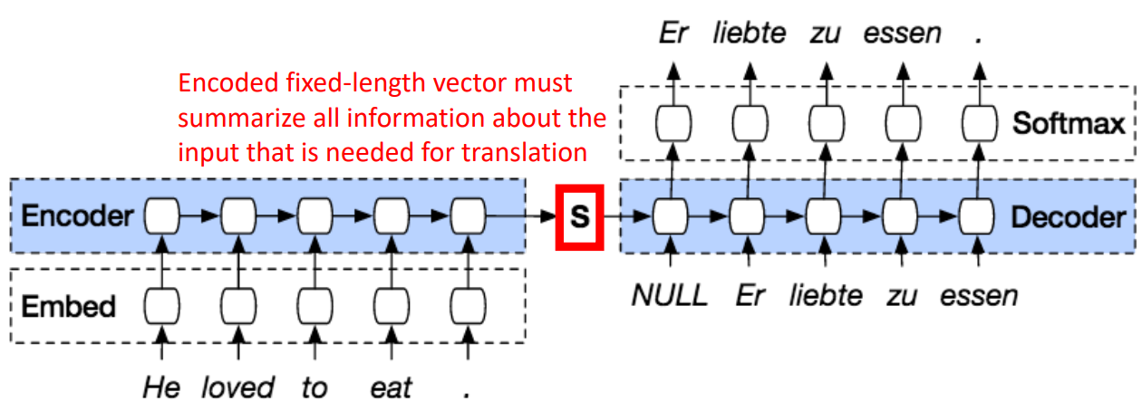
Task: Machine Translation
Introduction to Attention
Session 18

Slide 13
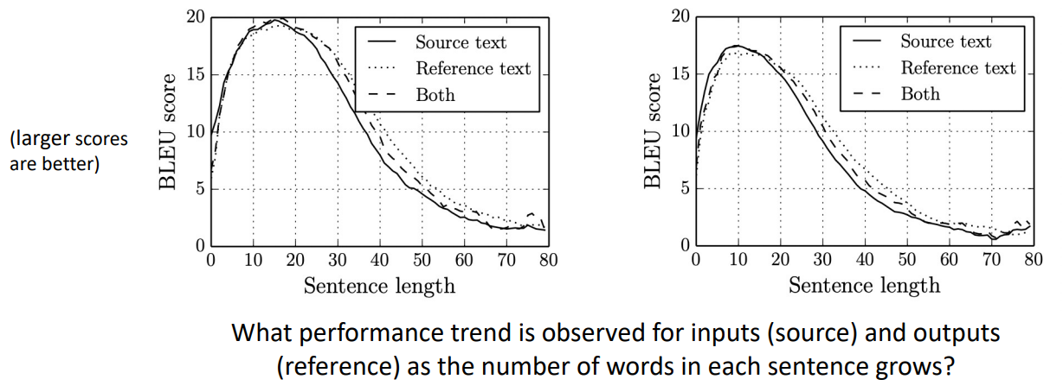
Task: Machine Translation
Introduction to Attention
Session 18

Slide 14
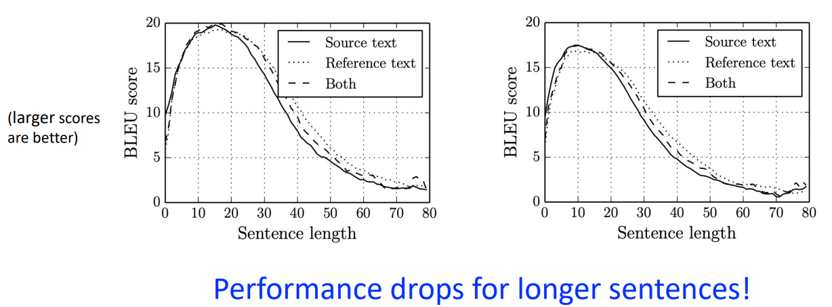
Task: Machine Translation
Introduction to Attention
Session 18

Slide 15
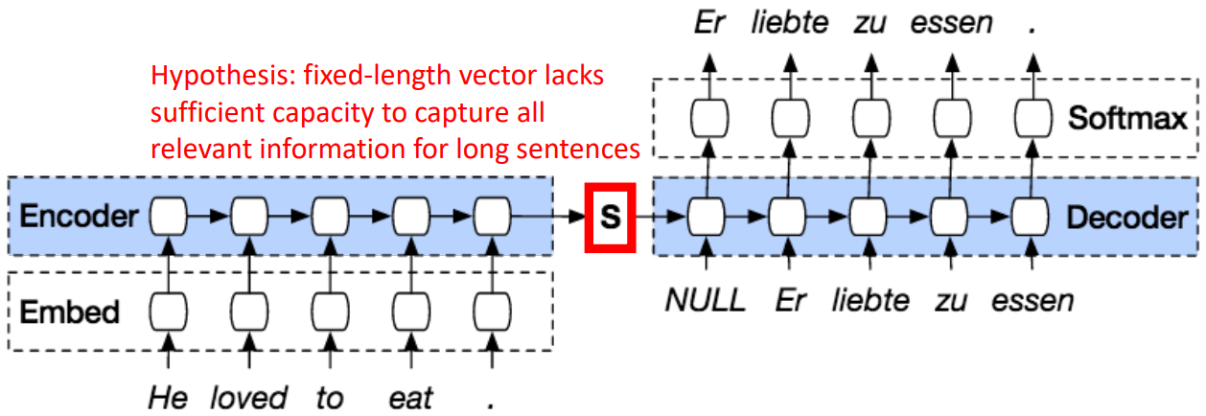
Problem: Performance Drops as Sentence Length Grows
Bottleneck problem!
Introduction to Attention
Session 18

Slide 16
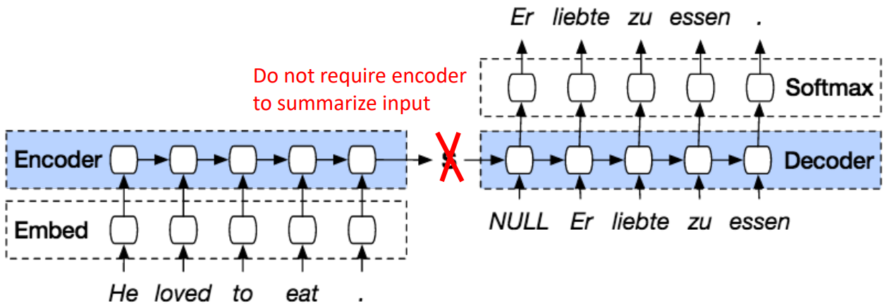
How to preserve Performance for Long Sequences?
Introduction to Attention
Session 18

Slide 17
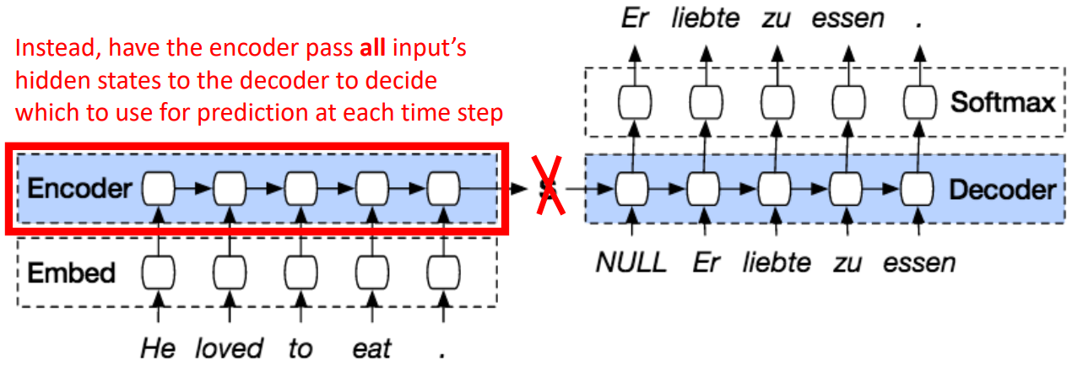
How to preserve Performance for Long Sequences?
Introduction to Attention
Session 18

Slide 18
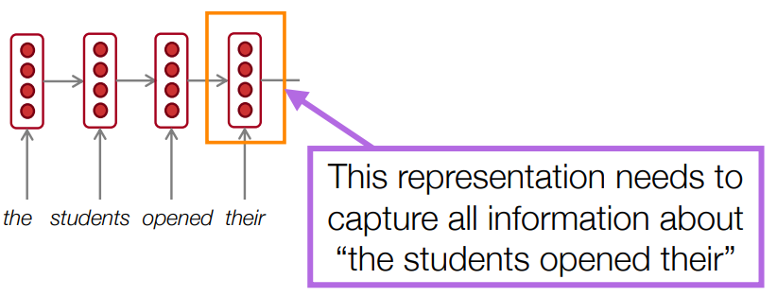
Idea: What If We Use Multiple Vectors?
Introduction to Attention
Session 18

Slide 19
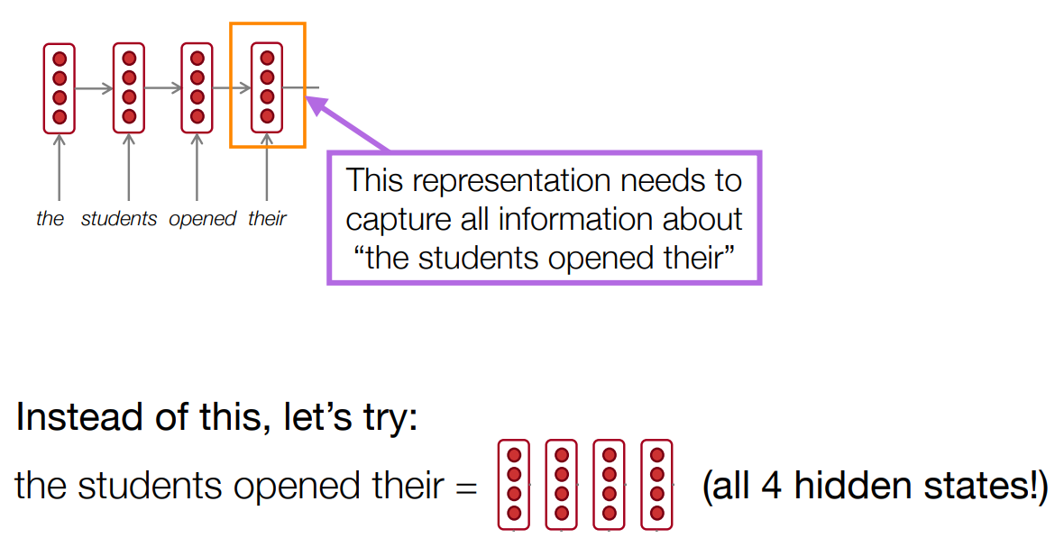
Idea: What If We Use Multiple Vectors?
Introduction to Attention
Session 18

Slide 20
The Solution: Attention
Attention mechanisms (Bahdanau et al., 2015) allow language models to focus on a particular part of the observed context at each time step.
Originally developed for machine translation, and intuitively similar to word alignments between different languages
Introduction to Attention
Session 18

Slide 21
How does attention work?
In general, we have a single query vector and multiple key vectors. We want to score each query-key pair.
In a neural language model, what are the queries and keys?
Introduction to Attention
Session 18

Slide 22
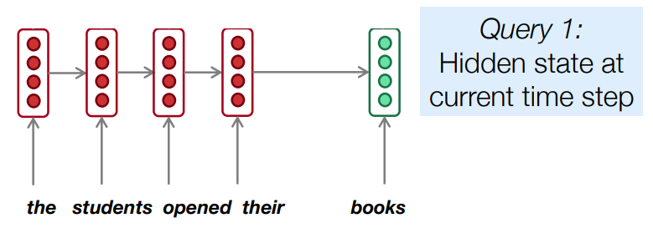
Attention Mechanisms in Neural Language Models
Introduction to Attention
Session 18

Slide 23
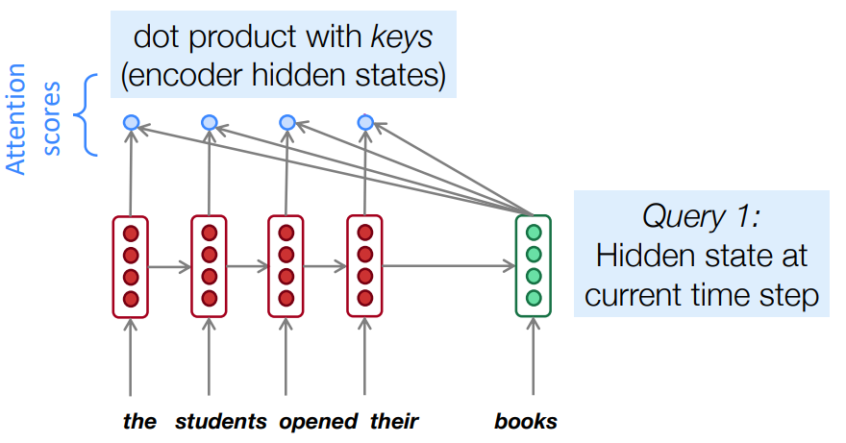
Attention Mechanisms in Neural Language Models
Introduction to Attention
Session 18

Slide 24
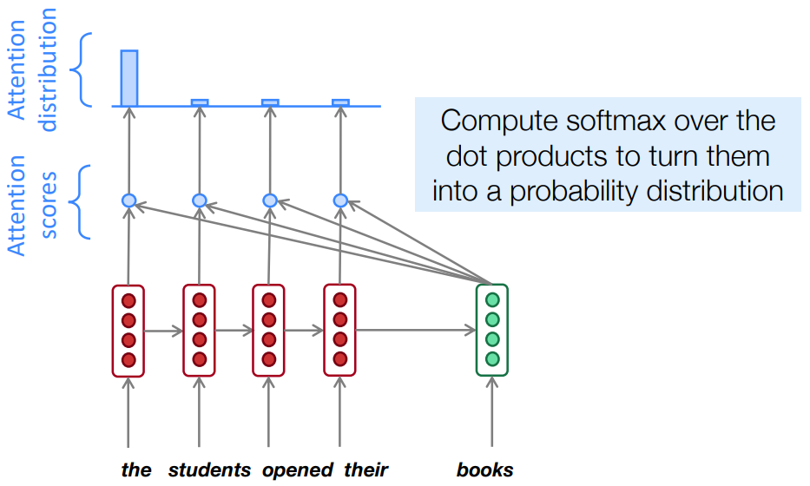
Attention Mechanisms in Neural Language Models
Introduction to Attention
Session 18

Slide 25
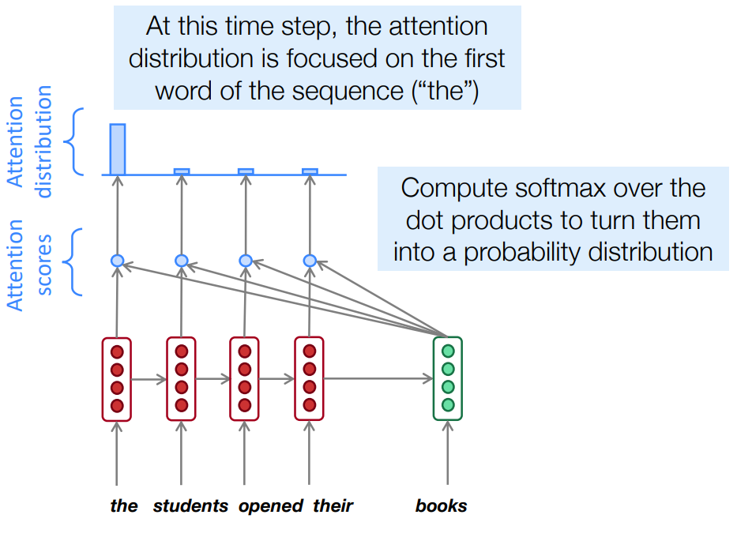
Attention Mechanisms in Neural Language Models
Introduction to Attention
Session 18

Slide 26
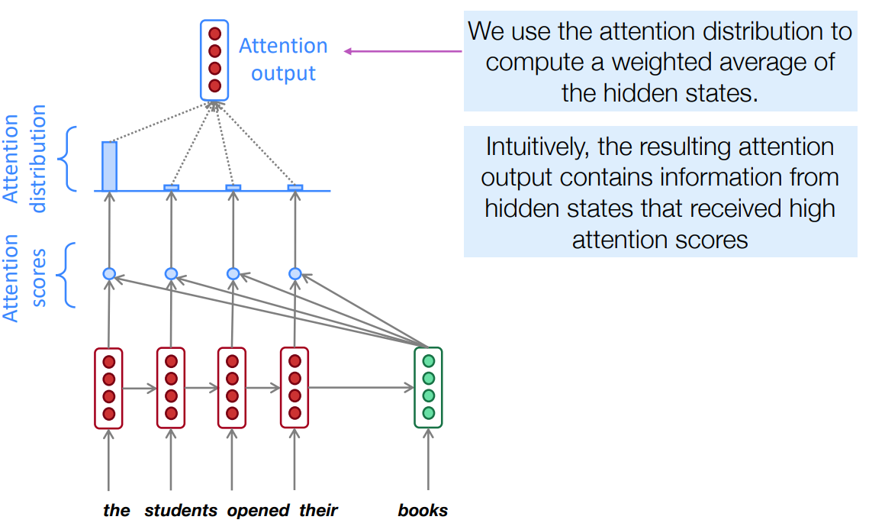
Attention Mechanisms in Neural Language Models
Introduction to Attention
Session 18

Slide 27
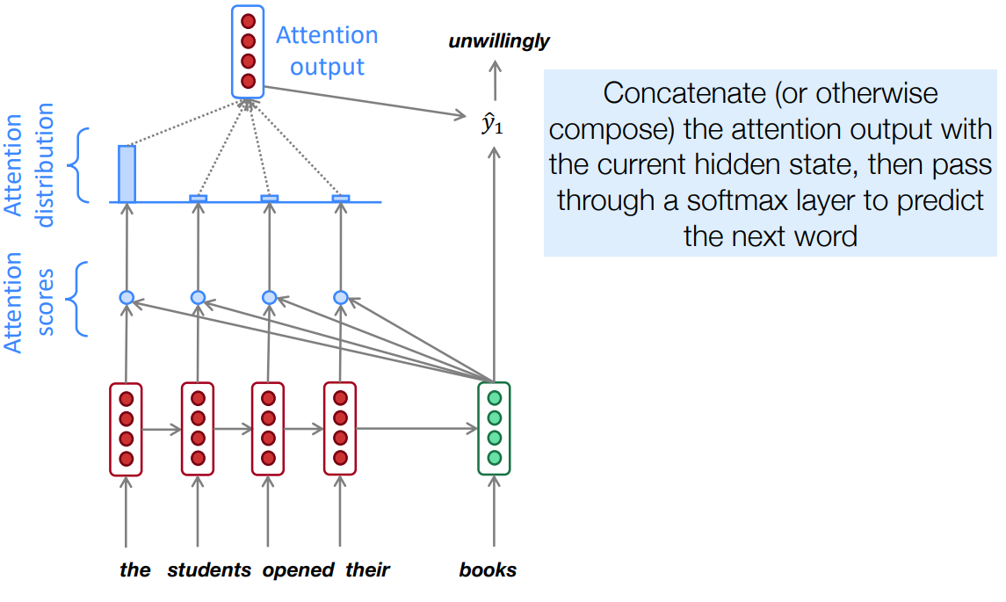
Attention Mechanisms in Neural Language Models
Introduction to Attention
Session 18

Slide 28
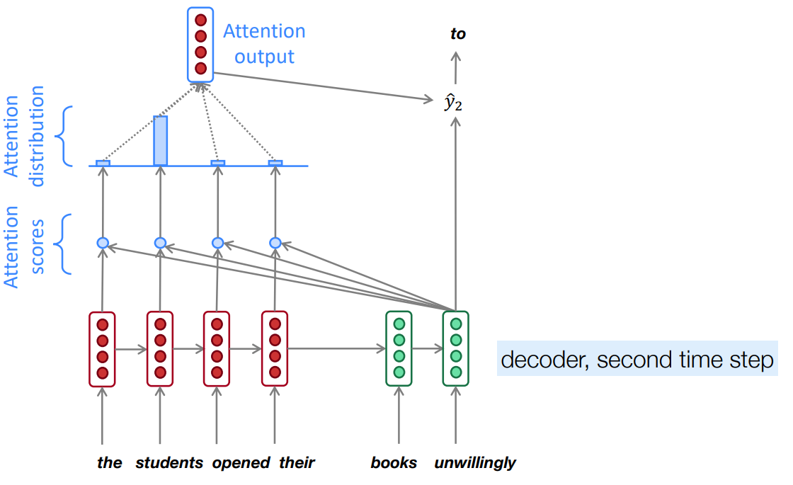
Attention Mechanisms in Neural Language Models
Introduction to Attention
Session 18

Slide 29
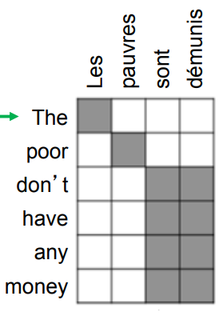
Attention Mechanisms in Neural Language Models
Attention solves the bottleneck problem
Attention allows decoder to look directly at source; bypass bottleneck
Attention helps with vanishing gradient problem
Provides shortcut to faraway states
Attention provides some interpretability
By inspecting attention distribution, we can see what
the decoder was focusing on
We get an alignment for free!
This is cool because we never explicitly trained an
alignment system
The network just learned alignment by itself
Introduction to Attention
Session 18

Slide 30
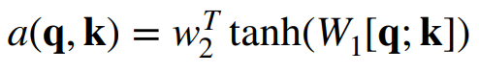
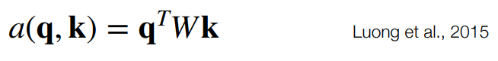
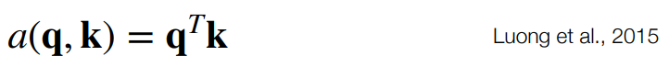
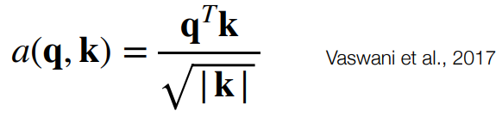
Many Variants of Attention
Original formulation:
Bilinear product:
Dot product:
Scaled dot product:
Introduction to Attention
Session 18

Slide 31
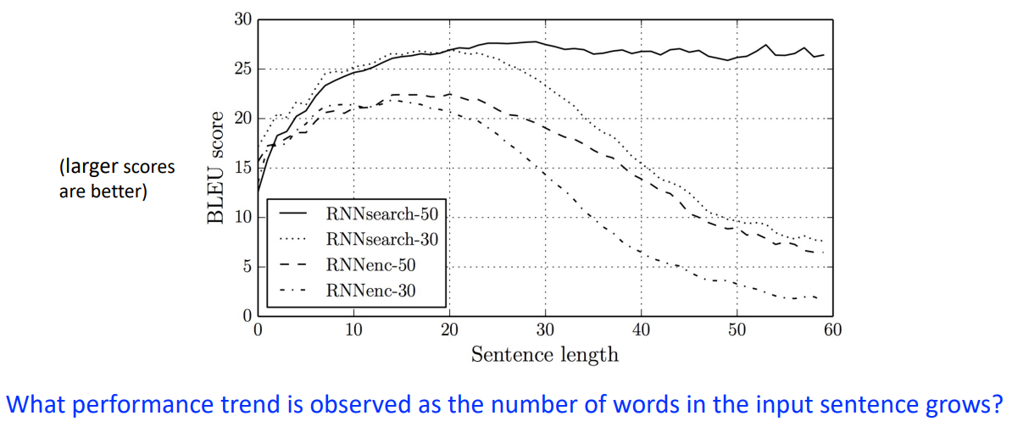
Analysis of Attention Models
Introduction to Attention
Session 18

Slide 32
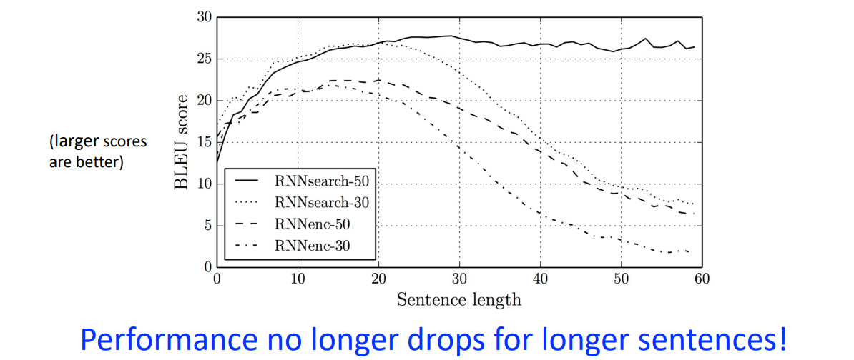
Analysis of Attention Models
Introduction to Attention
Session 18

Slide 33
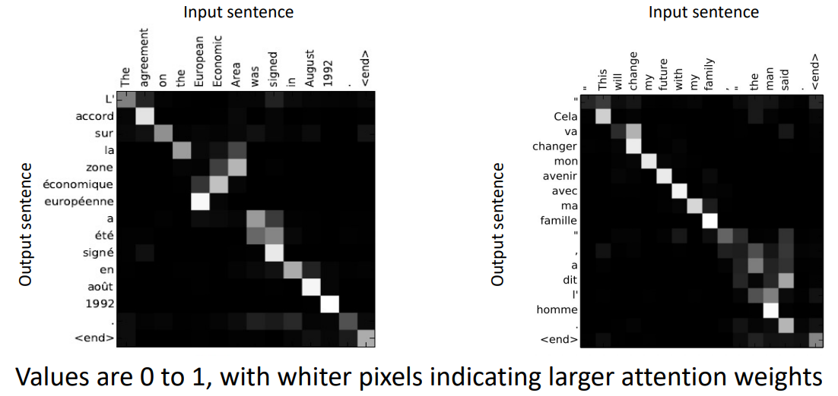
Visualizing Attention
Introduction to Attention
Session 18

Slide 34
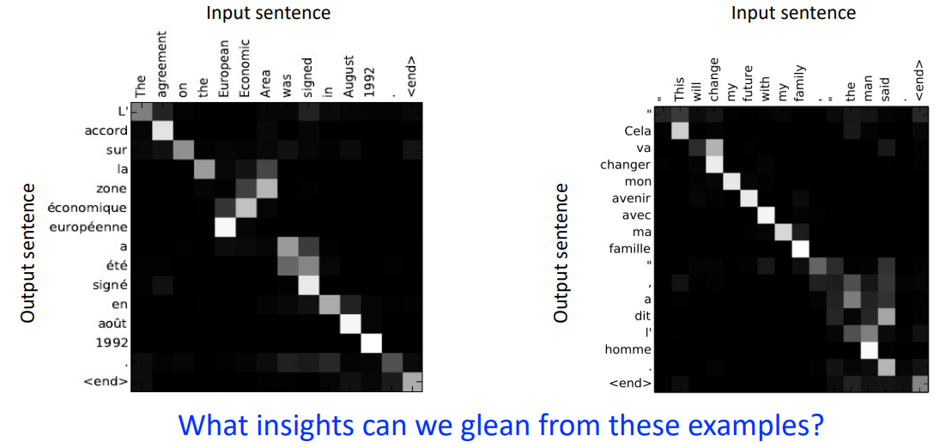
Visualizing Attention
Introduction to Attention
Session 18

Slide 35
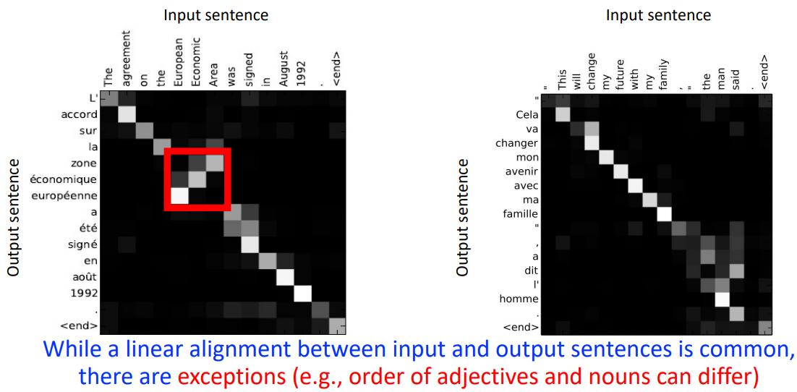
Visualizing Attention
Introduction to Attention
Session 18

Slide 36
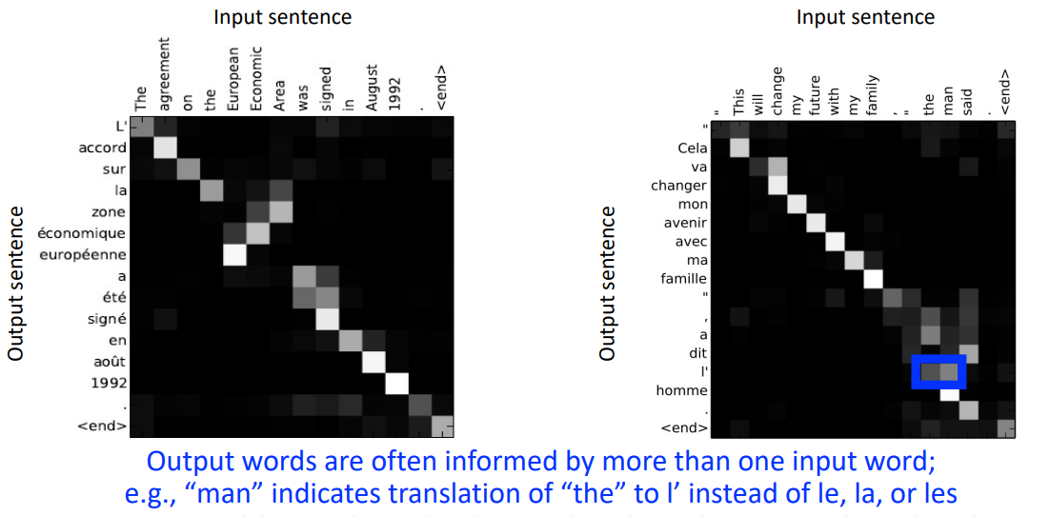
Visualizing Attention
Introduction to Attention
Session 18

Slide 37
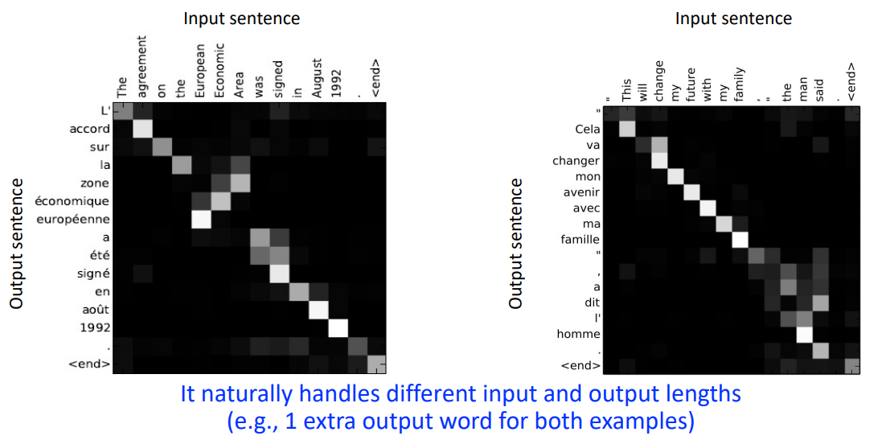
Visualizing Attention
Introduction to Attention
Session 18

Slide 38
Exercises
Let's implement a attention mechanisms with PyTorch.
Follow the instructions on the notebook: "seq2seq_translation_exercises.ipynb".
Introduction to Attention
Session 18

